Slide 1
SCRUM ROLES

Slide 2
Objectives:
After the class, you should be able to:
Identify the Scrum team roles and what each role is responsible for
Understand how popular Scrum is
Refresh the Scrum Pillars and Values
Appreciate the role of the Product Owner being close with the Scrum Team

Slide 3
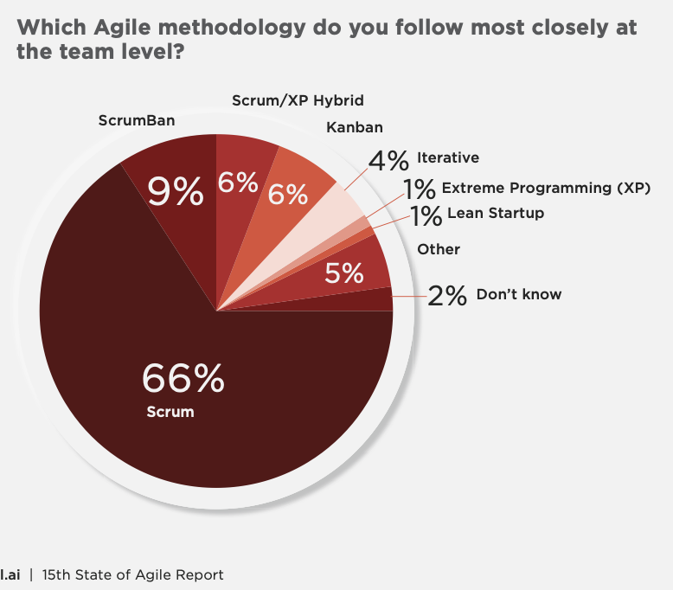
Source: Digital.AI 2021 State of Agile Survey
4k Respondents

Slide 4
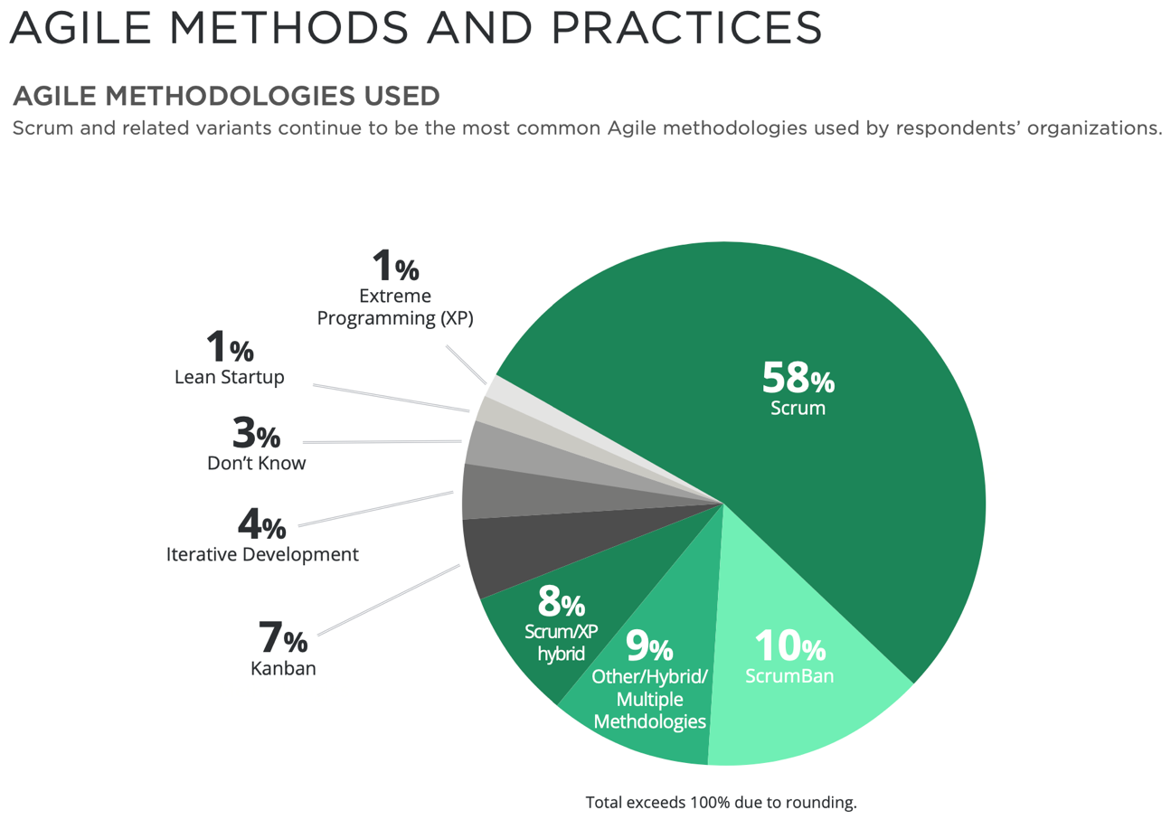
Source: Digital.AI 2020 State of Agile Survey
40k Respondents

Slide 5
Software Development Lifecycle
Steps to get from Idea to Software
Initiation
Planning
Analysis
Design
Development
QA Testing
Deployment
You go through these steps in both Waterfall and Agile Projects.
The difference is HOW and WHEN you do each step.

Slide 6
What is Agile? - NEW
“Agile” is an iterative and incremental approach to product development that builds and enhances products incrementally, instead of trying to deliver it all at once.
Notes:
What is “Agile?” – The Basics:
The Agile Manifesto was developed in 2001 at the end of the “dot.com era” when traditional value systems were shaken up and there was a change of attitude towards work:
Knowledge workers were constantly jumping from company to company causing companies much angst over losing employees and investments in employees who would leave after only a short time
This led to a lack of trust between employers and employees
This thinking, along with a result of the 9/11 tragedy was people were taking a step back and looking at their value systems; during the time leading up to this era, employees are putting in MAJOR overtime at work, working towards lucrative stock option payouts, etc.
The Agile Manifesto looked into ways to improve how we develop software along with developing new ways of thinking

Slide 7
Agile: A Different Way of thinking
Agile practices are light weight and easy to learn
New teams typically need help adopting the change
Change in how you think as well as what you do
Working with coaches and other experienced Agilists helps

Slide 8
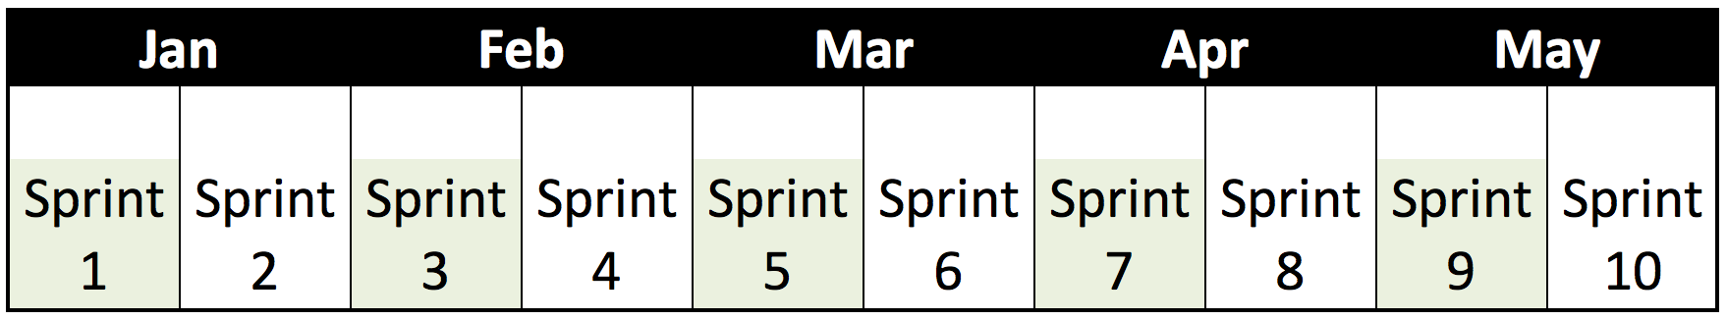
Agile Methodologies
Develop in short, iterative cycles called “Sprints”
Full lifecycle of development
Measure progress by features completed
Software delivered every sprint
Design
Develop
Test
Analysis
Sprint

Slide 9
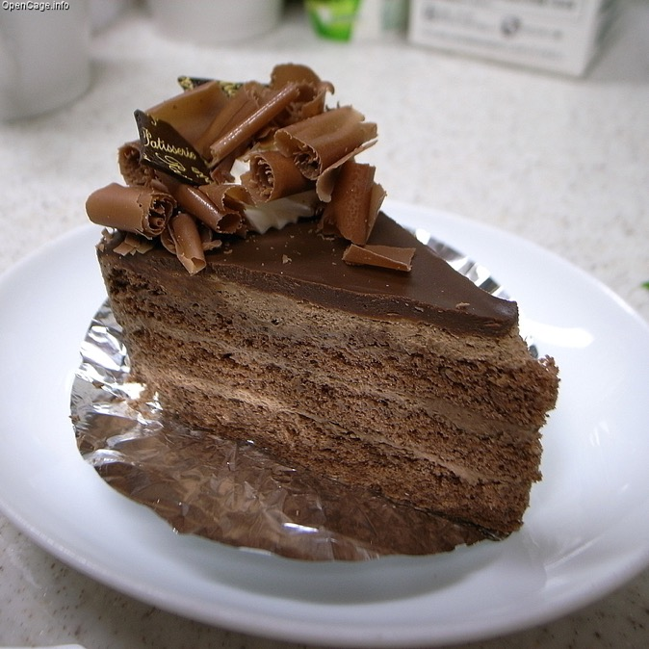
Vertical Product Development
Iterative and incremental delivery
Produce full “vertical” slice of the software at the end of each sprint
May not be useful enough to deploy to production
Delivers an increment of value towards the goal
Notes:
You may not be able to deliver them a full feature in 3 weeks but you can deliver a piece of it.
Metaphorically speaking, you may not be able to deliver the whole cake, but you can deliver a small slice of the cake.
AND, May not be fully valuable to the customer but it is a piece of the value that is demonstrable and potentially shippable to the customer.
the layers of the cake are meant to reflect layers of software… we want a small slice of functionality that goes through all layers… from the UI to Platform layer.
Let me give you an example… have you ever heard of the acronym CRUD????
JOKE: Don’t even ask about the kind of pictures I found when I went looking for an image of CRUD.
CRUD
What does that mean?
A transaction that you can do the CR of the CRUD acronym but not the UD i.e. you can create and read a record but not update and delete… not yet… not until the next iteration perhaps.
A logon that is a simple user name and with the same password for everyone to be supplanted in the future with full LDAP authentication
Q: Can you give me any other examples?

Slide 10
Agile: A collection of tools & methods
Scrum: | Framework focused on how teams and their customers interact
Kanban: | Develops a continuous flow of value and limits the amount of work in progress. Great for work that can’t be planned
XP: | eXtreme Programming. Scrum concepts plus a variety of technical practices: continuous integration, test driven development, test automation, paired programming
SAFe: | Scaled Agile Framework. A set of best practices that build on top of Scrum practices to coordinate the efforts of many teams working in concert.

Slide 11
Why Agile and SCRUM Desirable?

Slide 12
The Problem
Annual surveys show that very few IT Projects are considered successful.
Success: Delivered on time, within budget, with desired features
Challenged: Delivered but with cost, schedule or scope problems
Failed: Project was canceled before completion
Source: The CHAOS Manifesto; Standish Group 2012
Notes:
12

Slide 13
Why Agile?
Agile Projects:
Are faster to market
Are more productive than the industry average
Are less costly
Are adaptable to change
Have fewer defects in production
Source: The CHAOS Manifesto; Standish Group 2012
Notes:
13

Slide 14
Scrum Fundamentals

Slide 15
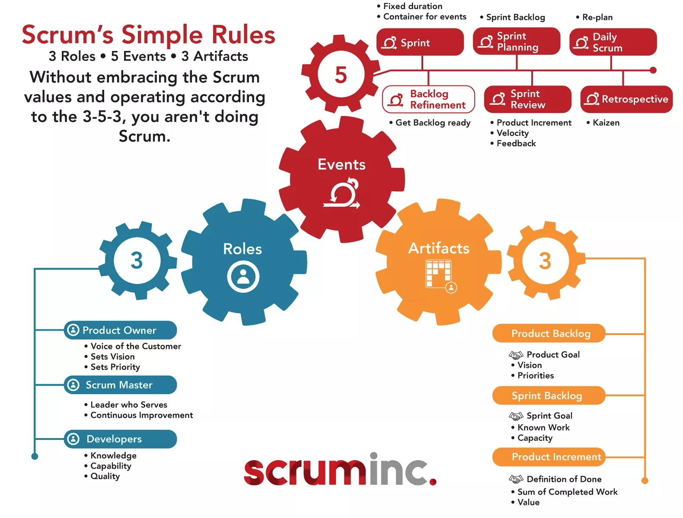
Elements of Scrum
We will focus on roles today

Slide 16
Scrum Theory
Scrum is based on empirical process control.
Used for processes that are imperfectly designed and generate unpredictable results
Iterative, incremental approach to optimize predictability and control risk
Defines values, roles, events, and outputs

Slide 17
Pillars of Scrum
TRANSPARENCY
INSPECTION
ADAPTION
Important information is available to everyone
Frequent demonstration at regular intervals of working, potentially production ready product enhancements
Adjust plan, scope, process, tools – whenever it is necessary
Notes:
Is there an exercise we can do for this?

Slide 18
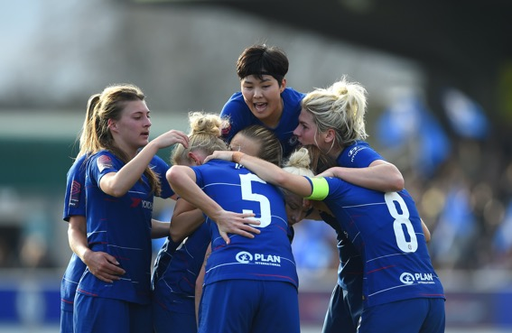
Scrum Values
Focus | Because we focus on only a few things at a time, we work well together and produce excellent work. We deliver valuable items sooner.
Courage | Because we are not alone, we feel supported and have more resources at our disposal. This gives us the courage to undertake greater challenges.
Openness | As we work together, we practice expressing how we're doing and what's in our way. We learn that it is good to express concerns so that they can be addressed.
Commitment | Because we have great control over our own destiny, we become more committed to success.
Respect | As we work together, sharing successes and failures, we come to respect each other and to help each other become worthy of respect.

Slide 19
The Scrum Team

Slide 20

3 Scrum Roles
Product Owner
Represents the customer
Scrum Master
Facilitates the process
Development Team
Builds the software
Notes:
Potentially many responsibilities and different skills on an agile team, but only four specific roles.
No team lead, business analyst, technical liaison, feature point estimator, operational project manager, etc.

Slide 21
Class Exercise
Scrum Roles & Values:
Match each SCRUM Role to a Responsibility
I’m your customer, try work like a true agile team!

Slide 22

Product Owner
Creates and maintains the vision for the product
Owns the “the product backlog”
Product backlog is a list of all known requests
Defines acceptance criteria for each request
The “requirements”
Prioritizes the requests
Decides content of release
Keeps team & stakeholders aligned
Notes:
Defines and prioritizes product features
Adjusts features and priority as needed to meet product goals
Accepts or rejects user stories
The actual customer or customer proxy
Responsible for profitability of the product (ROI)

Slide 23

Scrum Master
Scrum champion
Ensures the team follows Scrum practices
Facilitator and servant leader
Encourages team self organization
Helps to remove roadblocks
Facilitates Scrum events
Enables close cooperation across all roles and functions
Protects the team from distractions
NOT the Project Manager!
Notes:
Keeps the daily scrum on task
Tracks story/task status throughout the sprint
Raises team concerns and roadblocks to product owner
Can be a manager or peer; peers are a great way to start
Removes impediments so the team can focus on the work at hand

Slide 24
Class Exercise
What Type of Scrum Master is that?

Slide 25

Development Team
Cross-functional
Generalizing specialist
Everyone needed to complete the job is a member of the team
Owns estimates and tactical planning
Tasks, Estimates, Volunteers to perform work
Develops the functionality
Demos to the customer and stakeholders
Notes:
Small teams (7 +/- 2)
Self-organizing to achieve product goals
Assists in all levels of agile planning
Demonstrates work to product stakeholders (payday for developers)!
Team members check their ego at the door as they wear multiple hats on an agile team
Organize and assign their own work
Has the right to do everything within the project boundaries to reach the goal

Slide 26

Stakeholders
Anyone else with an interest in the outcome of the project
Not allowed to disrupt the team’s work
Greatest participation will be at the end of the sprint
Notes:
Cannot assign work or change priorities

Slide 27
Class Exercise
Product Owner’s Role

Slide 28
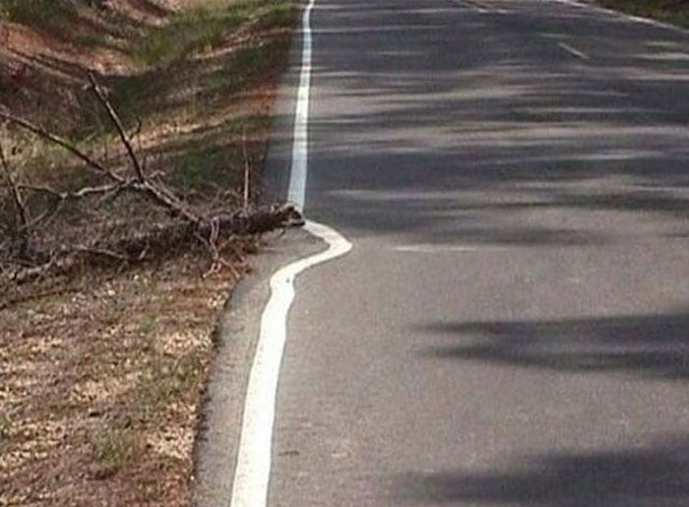
Team member first!
Specialist
Second
Scrum Teams are Different!
Small
Stable
Self Organizing
Empowered
Cross Functional
Interdependent
Continuous Collaboration

Slide 29
Next Up…. LEAN START UP
THIS WILL BE ONLINE – DETAILS WILL BE PROVIDED DURING THE WEEK
WE WILL MEET AT THE SAME TIME – 5:40 PM Monday November 22

Slide 30
Have a great & healthy week
and remember…
Think Lean,
Be
Agile!

